Slide 1
Session Polls
Walkthrough and attendee experience

Slide 2
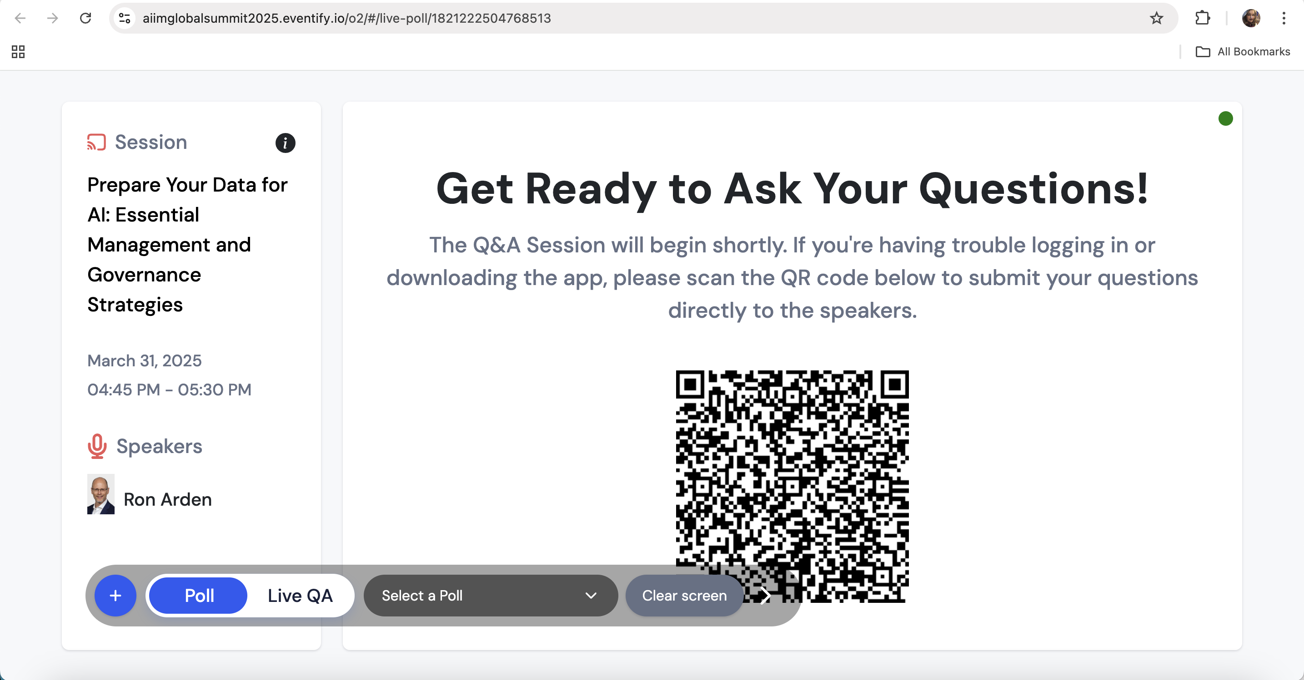
Your Unique URL for Polling
After submitting your poll questions, the AIIM team will send you your unique poll URL.
The link will include your unique QR code for your polling questions and Q&A.

Slide 3
Your Unique URL for Polling
Include the link and QR code into your PowerPoint slide for your presentation.
Attendees will scan the QR code to participate in polling.
During polling, go to the link/URL outside of your presentation to see live interaction.

Slide 4
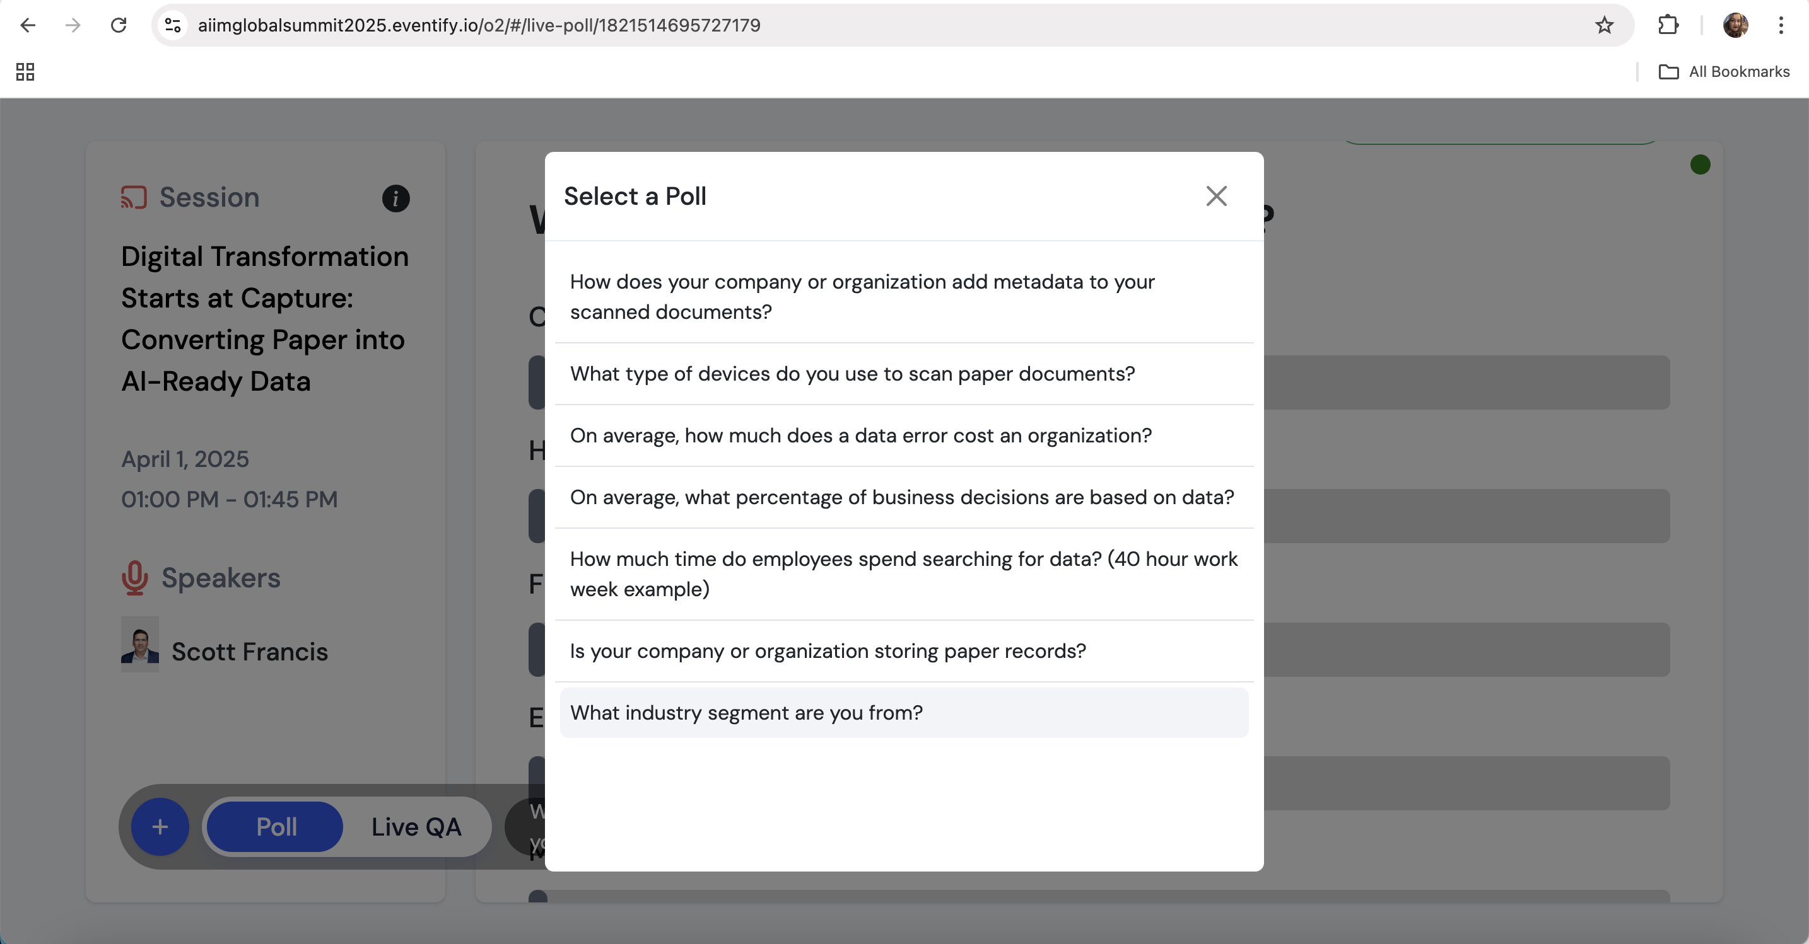
Selecting Your Polling Question
Select your poll question, by clicking on the dropdown circled in yellow.
Your submitted poll questions will appear in the pop-up screen.

Slide 5
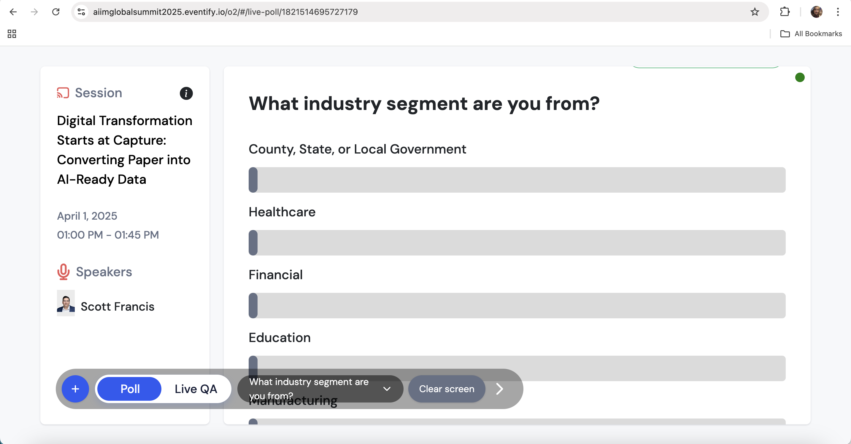
Live Results
After you select your polling question, your polling results will appear live as attendees submit their responses.

Slide 6
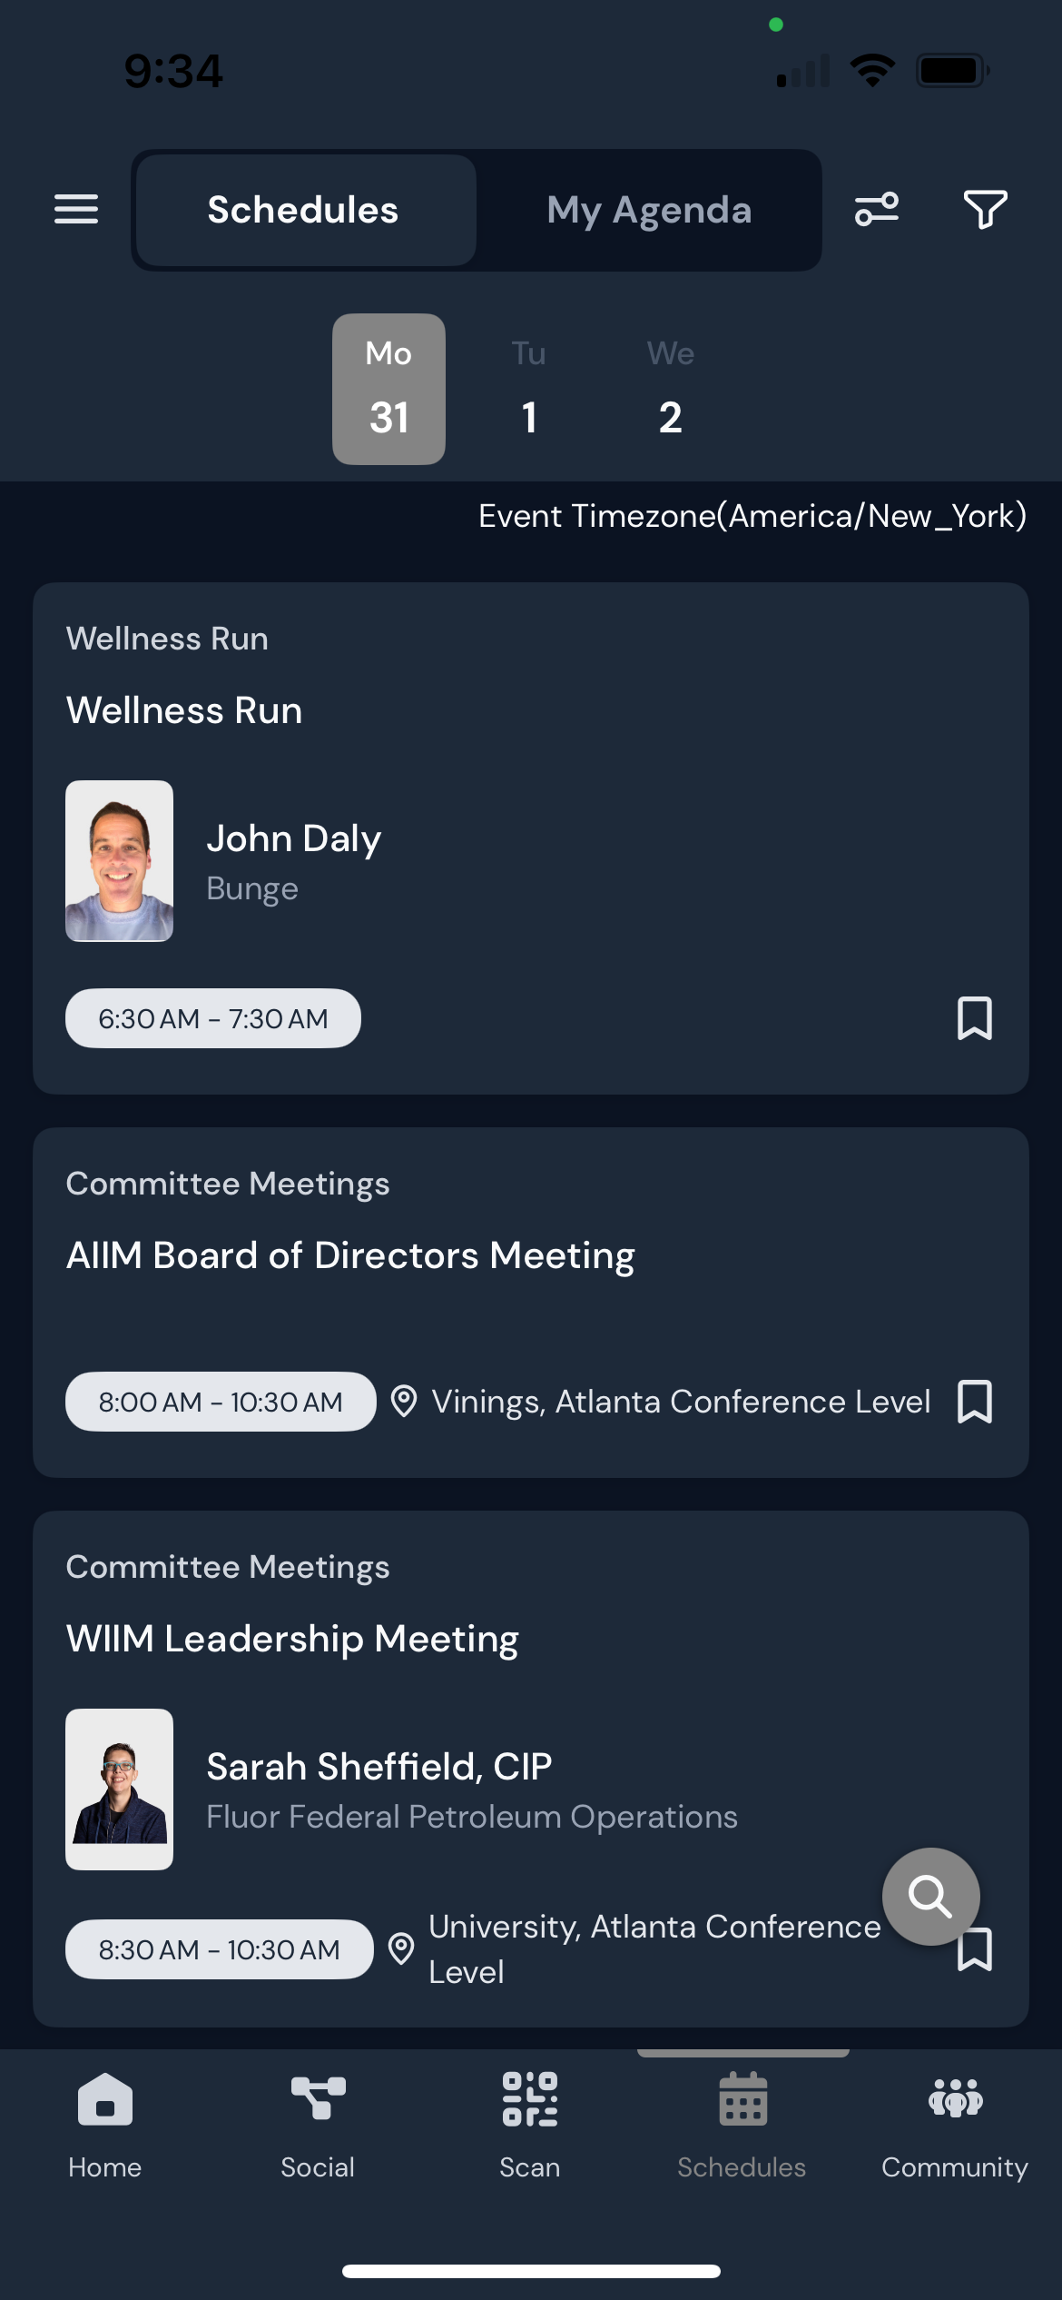
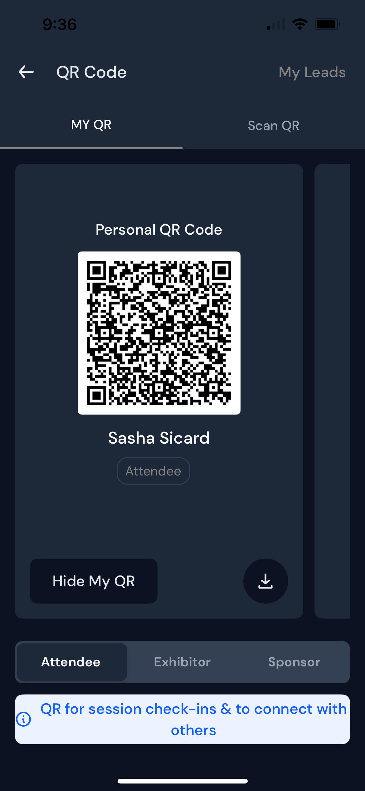
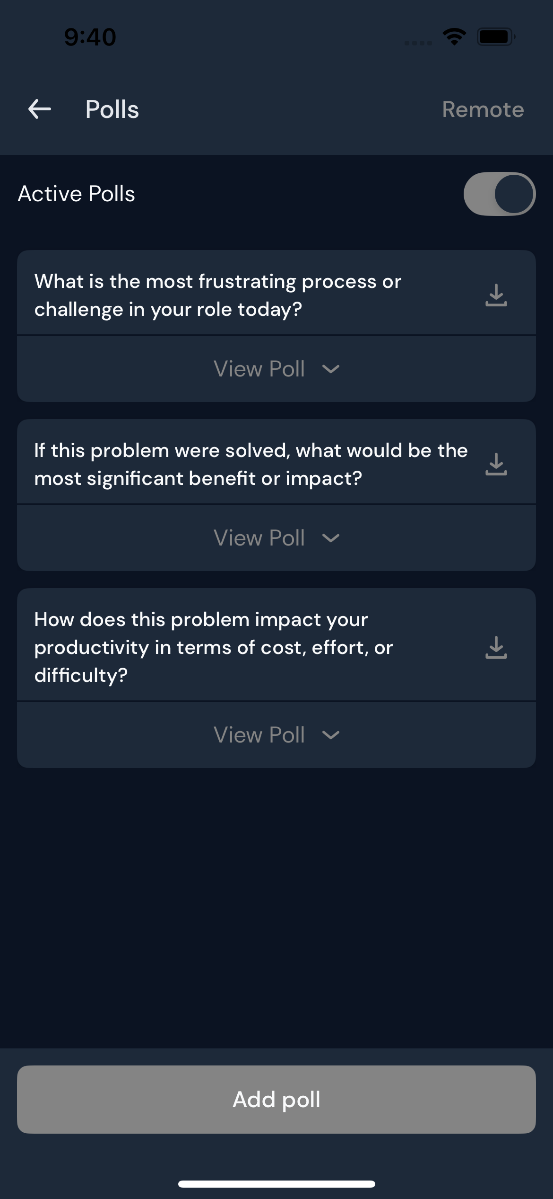
Attendee Experience
Attendees will be able to scan the QR code with their event app.
They will see all polling options and participate.
Note: Clearly highlight which poll question is being currently asked.

